Slide 1

ECG BIOMETRIC AUTHENTICATION: A COMPARATIVE ANALYSIS
Domain: Matlab Technology: Image processing

Slide 2
Index
Abstract
Introduction
Literature Review
Existing Method
Drawbacks
Proposed Method
Advantages
Applications
Software & hardware Requirements
Results
Conclusion
References

Slide 3
Abstract
The main theme of this project is to authenticate the user by using ECG signals. Electrocardiogram (ECG) is an electric signal of cardiac activity posing highly discriminative properties related to human recognition. ECG based authentication has gained much success in recent times however discriminant feature extraction and efficient pattern classification still encounter numerous challenges. In these present situations authentication methods became an indispensable urgent task to protect the integrity of the devices and the sensitive data. Passwords have provided to control the important data, but have shown their inherent vulnerabilities. We propose an authentication method, which can effectively provide the access to the user, which is known as ‘ECG Biometric Authentication’.

Slide 4
Introduction
Face owes its reputation mainly to being easily and non-intrusively accessible compared to other biometric traits like finger print or iris.
This apparent vulnerability of face has evoked great interest in the biometric community and many papers have been published on countermeasure studies.
Traditional visible liveness detection method still detects blinking, in other words, cannot distinguish a photo attack.
The goal of a biometric recognition system is to determine or verify the identity of an individual from his/her behavioral and/or biological characteristics..

Slide 5
Introduction
Biometrics refer to a person’s behavioral and biological characteristics such as their face, fingerprint, iris, voice, hand geometry, and gait. Biometric traits can be highly discriminative yet less easily lost or stolen.
Applications include criminal identification, airport checking, computer or mobile device log-in, building and critical infrastructure access control, digital multimedia rights control, transaction authentication, voice mail, and secure teleworking.
Various biometrics have been investigated, from the most conventional including fingerprint, iris, face, and voice, to more emerging modalities such as gait, hand-grip, ear, and electroencephalograms.

Slide 6
Literature review
S.NO | Journal Type with year | Authors | Title | Outcomes
1 | IEEE Conference (2015) | Zahid Akhtar | Biometric liveness detection: Challenges and research opportunities. | Detect spoofing attacks.
2 | IEEE Access (2014) | Nesli Erdogmus | Spoofing face recognition with 3d masks | High accessibility.
3 | IEEE conference (2015) | Abdenour Hadid | Biometrics systems under spoofing attack: an evaluation methodology and lessons learned | Defend against concerted-effort spoofing attacks.
4 | IEEE Conference (2013) | Neslihan Kose | On the vulnerability of face recognition systems to spoofing mask attacks. | Detect mask attacks.
5 | IEEE transaction (2017) | Patrick PK Chan | Face liveness detection using a flash against 2d spoofing attack | High accuracy, complexity and low setup cost.

Slide 7
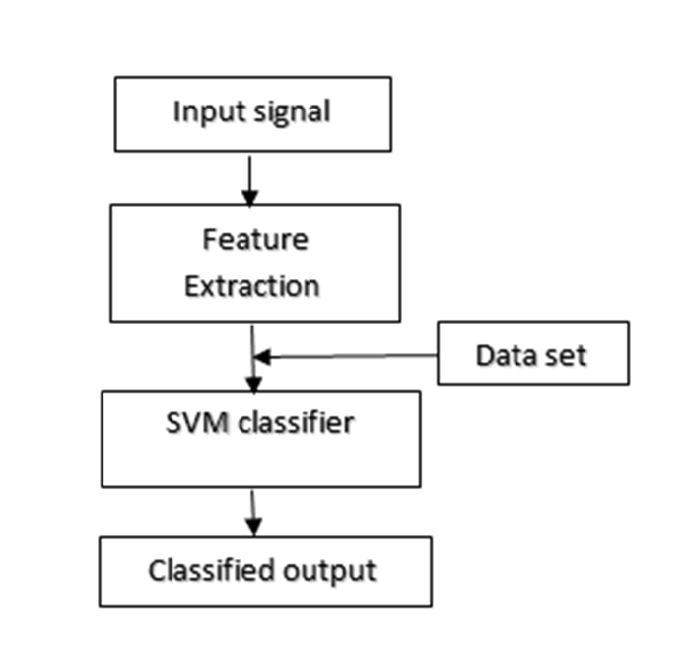
Existing method
The below shows the block diagram of existing method.
Fig: Block Diagram of Existing Method

Slide 8
Existing method
The verification based on the Euclidian distance is simple but not adequate for employing the authentication using the intra-body propagation signal in practical applications,
So that we introduce the support vector machine (SVM) into the verification process in order to improve the verification performance further.
As a pattern classification method based on supervised learning, the SVM has been proposed. The SVM learns a separating hyperplane which maximizes the distance (margin) between two classes and so performs higher separation capability for unlearned data.
Intrabody propagation signals for all users are measured and then their spectra are extracted and smoothed and normalized. The smoothing is the same as the conventional method.

Slide 9
Existing method
There have been proposed three transmission modes for the intrabody communication: the simple circuit type, the electrostatic coupling type, and the waveguide type.
Consists of general-purpose measuring instruments: a signal generator, digital oscilloscope as a detector and body surface electrodes with gelled pads.
The spectrum of the intrabody propagation signal is expected to be as individual features while for that it is necessary to examine which frequency bands should be used for better verification performance.
The verification stage, each user declares who oneself is by giving his/her name or ID number to the system, which specifies the template. And the intrabody propagation signal for verification .

Slide 10
Disadvantages
Choosing a “good” kernel function is not easy.
Long training time for large datasets.
Difficult to understand and interpret the final model, variable weights and individual impact.

Slide 11
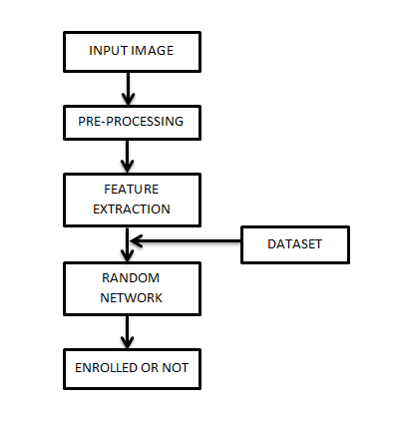
Proposed method
The below diagram represent the block diagram of the proposed method.
Figure: Block diagram of proposed method.

Slide 12
Proposed method
This proposed method is implemented to protect the data and devices securely. We use ECG based dataset for authentication which is collected from the given paper.
We have enrollment and verification stages. The signal is plotted form this given database. Then we apply the IIR butterworth filter for filtering operation.
This type of signal processing filter designed to have a frequency response as flat as possible in the pass band. It is also referred to as a maximally flat magnitude filter.
Butterworth showed that successively closer approximations were obtained with increasing numbers of filter elements of the right values.

Slide 13
Proposed method
Non fiducial is used for feature extraction. Daubechies wavelet is applied in two phases. The Daubechies wavelets, based on the work of Ingrid Daubechies, orthogonal wavelets defining a discrete wavelet transform and characterized by a maximal number of vanishing moments for some given support.
After that network random algorithm is performed for biometric authentication. Two signals with equivalent features arranged in the same order can appear very different due to differences in the durations of their sections.
If the difference between two phase’s features is zero then the dialog box shows that biometric is enrolled otherwise dialog box shows that biometric is not enrolled.

Slide 14
Advantages
Gives the better authentication results for biometric.
Accuracy is more.

Slide 15
Applications
Logical Access Control.
Physical Access Control.
Time and Attendance.
Law Enforcement.
Surveillance.

Slide 16
Software& hardware Requirements
Software: Matlab 2018a or above
Hardware:
Operating Systems:
• Windows 10
• Windows 7 Service Pack 1
• Windows Server 2019
• Windows Server 2016
RAM:
Minimum: 4 GB
Recommended: 8 GB

Slide 17
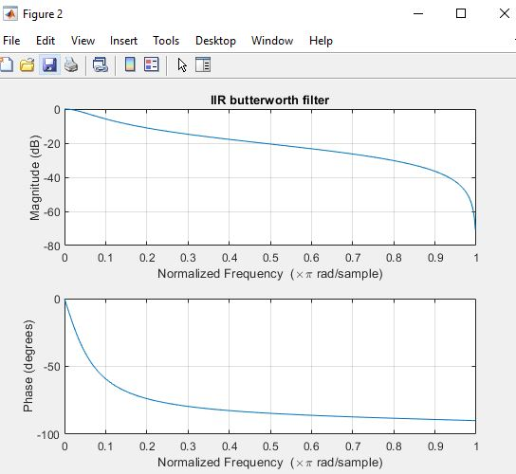
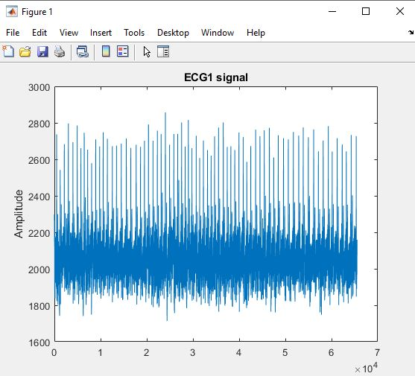
Results and Discussions
Electromyogram (EMG) is generated from the electrical activity of the muscles. The below diagram represent the generated ECG signal.
Figure1: ECG1 signal
The below figure represent the IIR butterworth filter.
Figure2: IIR butterworth filter

Slide 18
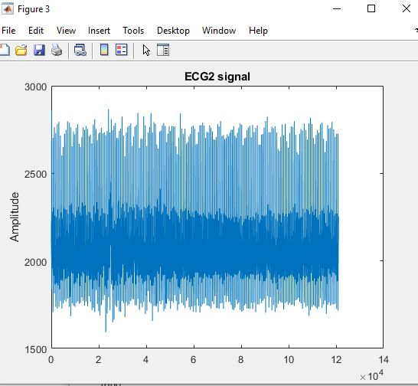
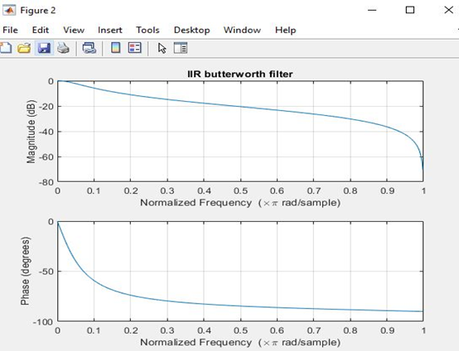
Results and Discussions
The below diagram represent the generated ECG signal of verification process.
Figure3: ECG2 signal
The below figure represent the IIR butterworth filter for verification phase.
Figure 4: IIR butterworth filter

Slide 19


Results and Discussions
Dynamic Time Warping (DTW) is a technique that compares two sequences that do not necessarily need to be the same lengths. After matching is performed.
Figure5: Dialog box represents matching or not.
Finally we calculate the accuracy of proposed implementation between filtered input signal and dynamic time warping.
Figure 6: Parameter calculation.

Slide 20
Conclusion
In this paper, we completely evaluate the impact of filtering type, segmentation, feature extraction and health status on ECG biometric by using the evaluation metrics such as accuracy. To protect the devices and data ECG dataset is used for authentication purpose. In other words, several experimental results were conducted to evaluate the impact of such important techniques for ECG biometric systems. This paper presents that our new proposed approach shows better performance when compared with the existing method.

Slide 21
References
[1] Nesli Erdogmus and Sebastien Marcel. Spoofing face recognition with 3d masks. IEEE transactions on information forensics and security, 9(7):1084–1097, 2014.
[2] Abdenour Hadid, Nicholas Evans, Sébastien Marcel, and Julian Fierrez. Biometrics systems under spoofing attack: an evaluation methodology and lessons learned. IEEE Signal Processing Magazine, 32(5):20–30, 2015.
[3] Neslihan Kose and Jean-Luc Dugelay. On the vulnerability of face recognition systems to spoofing mask attacks. In 2013 IEEE International Conference on Acoustics, Speech and Signal Processing, pages 2357– 2361. IEEE, 2013.

Slide 22
References
[4] Javier Galbally, Raffaele Cappelli, Alessandra Lumini, Guillermo Gonzalez-de Rivera, Davide Maltoni, Julian Fierrez, Javier Ortega-Garcia, and Dario Maio. An evaluation of direct attacks using fake fingers generated from iso templates. Pattern Recognition Letters, 31(8):725–732, 2010.
[5] Zahid Akhtar, Christian Micheloni, and Gian Luca Foresti. Biometric liveness detection: Challenges and research opportunities. IEEE Security & Privacy, 13(5):63–72, 2015.

